Slide 1

Boyer-Moore algorithm heuristics
Heuristics implementation and performance comparison
Rankić Nikola 3255/18
13M111GI – Computational Genomics
School of Electrical Engineering University of Belgrade

Slide 2
Content
Boyer-Moore algorithm
bad character and good suffix heuristics
Zhu Takaoka heuristic
Smith heuristic
heuristics time comparison
heuristics memory comparison

Slide 3
Boyer-Moore algorithm
online exact matching algorithm
compare characters from right to left
preprocessing and searching phase
naive algorithm vs. Boyer-Moore - try to skip as much as possible aligments using knowledge gained from character comparisons
rules to skip aligments = heuristics

Slide 4
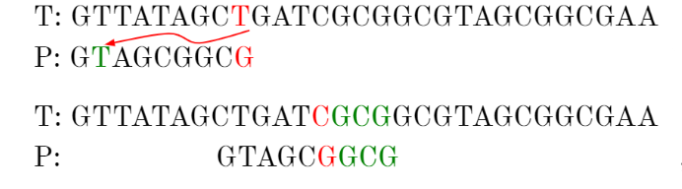
Bad character rule
upon mismatch, let b be the mismatched character in text
skip alignments until:
b matches its opposites in pattern
or pattern moves past b
* 6 aligments skipped

Slide 5
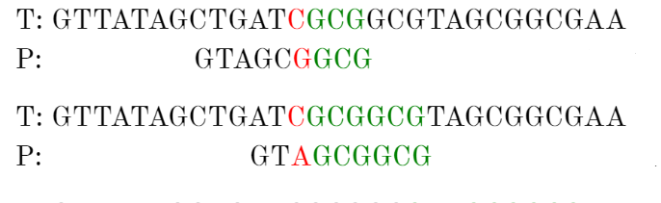
Good sufix rule
let t be the substring of text that matched a suffix of pattern
skip alignments until:
t matches opposite characters in pattern
or a prefix of pattern matches a sufix of t
or pattern moves past t
* 2 aligments skipped

Slide 6
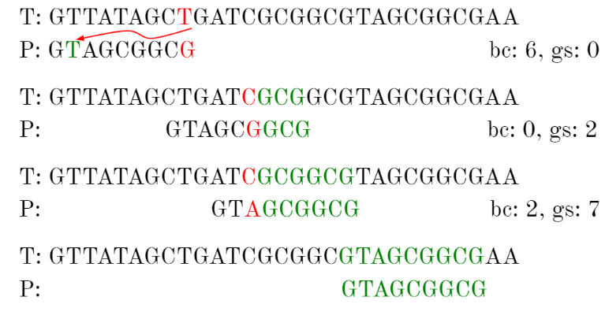
Boyer-Moore heuristic
after each alignment, use bad character or good sufix rule, whichever skips more

Slide 7
Zhu-Takaoka heuristic
change to bad character rule
uses two consecutive characters of text which are opposite to rightmost characters in pattern to compute the bad character shift
uses good suffix rule
searching phase in O(mn) time complexity
preprocessing phase in O(m+σ²) time and space complexity where σ is length of alphabet

Slide 8
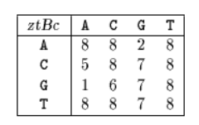
Zhu-Takaoka preprocessing
Zhu-Takaoka bad character table - for each pair of characters (a, b), with a, b in alphabet, compute the rightmost occurrence of ab in pattern[0 .. m-2]
for a,b in alphabet: ztBc[a,b]=k if:
k<m-2 and pattern[m-k..m-k+1]=ab and ab does not occur in pattern[m-k+2..m-2]
k=m-1 and pattern[0]=b and ab does not occur in pattern[0..m-2]
k=m and pattern[0]≠b and ab does not occur in pattern[0..m-2]
pattern
G C A G A G A G

Slide 9
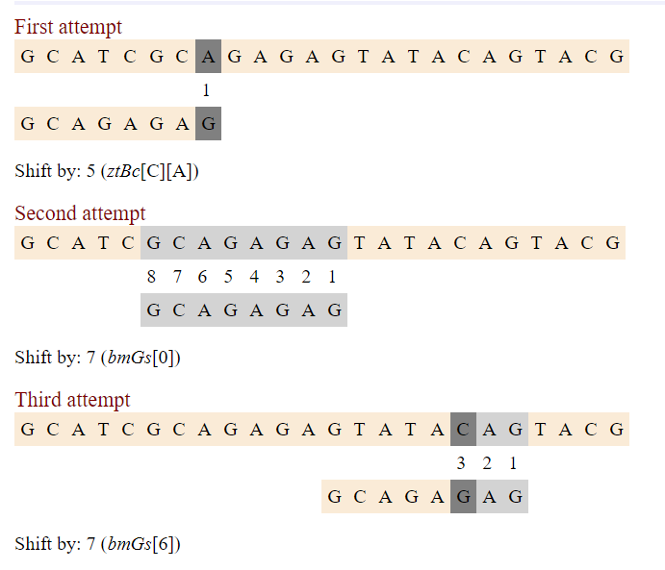
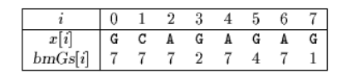
Zhu-Takaoka example

Slide 10
Smith heuristic
uses only bad character shift
combines and takes maximum of two different bad character rules:
Horsepool bad character shift: size of shift is determined by the character in text opposite to rightmost charcater in pattern
Quick search bad character shift: size of shift is determined by the character in text after character opposite to rightmost charcater in pattern
searching phase in O(mn) time complexity
preprocessing phase in O(m+σ) time and space complexity

Slide 11
Smith preprocessing
two different one dimensional tables:
Horsepool table (for c in alphabet):
hsBc[c]=min{i : 0 < i ≤ m-1 and pattern[m-1-i]=c} if c occurs in pattern, m otherwise
Quick search table (for c in alphabet):
qsBc[c]=min{i : 0 < i ≤ m and pattern[m-i]=c} if c occurs in pattern, m+1 otherwise
preprocessing phase in O(m+σ) time and space complexity
pattern
G C A G A G A G
c | A | C | G | T
hsBc[c] | 1 | 6 | 2 | 8
c | A | C | G | T
qsBc[c] | 2 | 7 | 1 | 9
Horsepool table
Quick search table

Slide 12
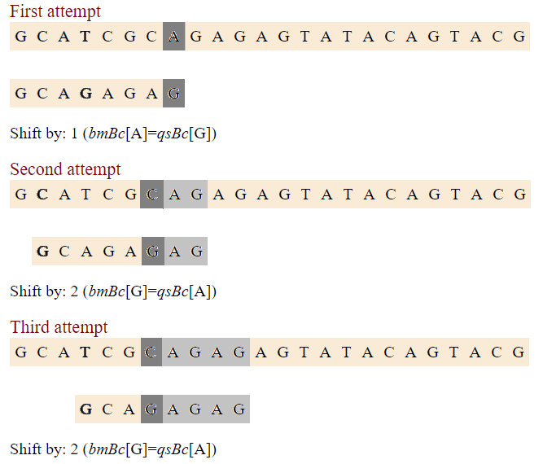
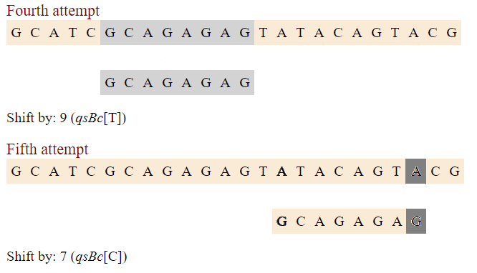
Smith example
c | A | C | G | T
hsBc[c] | 1 | 6 | 2 | 8
c | A | C | G | T
qsBc[c] | 2 | 7 | 1 | 9

Slide 13
Testing parameters
Tests:
Coffe arabica - chromosome 1c
patterns: ATGCATG, TCTCTCTA, TTCACTACTCTCA
Mus pahari - chromosome X
patterns: ATGATG, CTCTCTA, TCACTACTCTCA
Vicugna pacos - chromosome 2
patterns: GGAGTC, CAGCCCCACGGA, AGCGCC

Slide 14
Heuristics time comparison

Slide 15
Heuristics memory comparison

Slide 16
thank you!

